Slide 1
Solving University Timetabling Problem Using Constraint Programming and Heuristics
Team Details
A. Chakradhar Goud (22EG105K07)
C. Nivas Reddy (22EG105K17)
Ch. Sai Girish (23EG505K03)
M. Pavan Pradhan (23EG505K04)
Project Guide
Mr Dasu Vaman Ravi Prasad
Assistant Professor

Slide 2
UML Diagrams
1. USE CASE DIAGRAM
2. CLASS DIAGRAM
3. OBJECT DIAGRAM
4. SEQUENCE DIAGRAM
5. ACTIVITY DIAGRAM
6.STATECHART DIAGRAM
7. COMPONENT DIAGRAM
8. DEPLOYMENT DIAGRAM

Slide 3
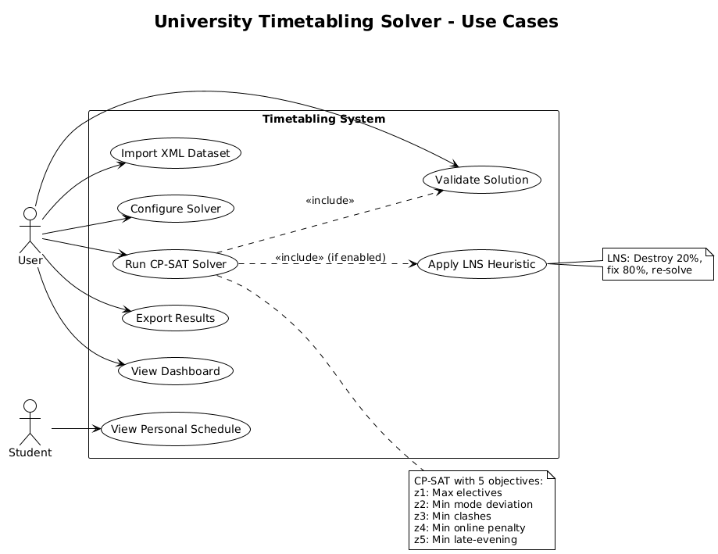
Usecase Diagram

Slide 4
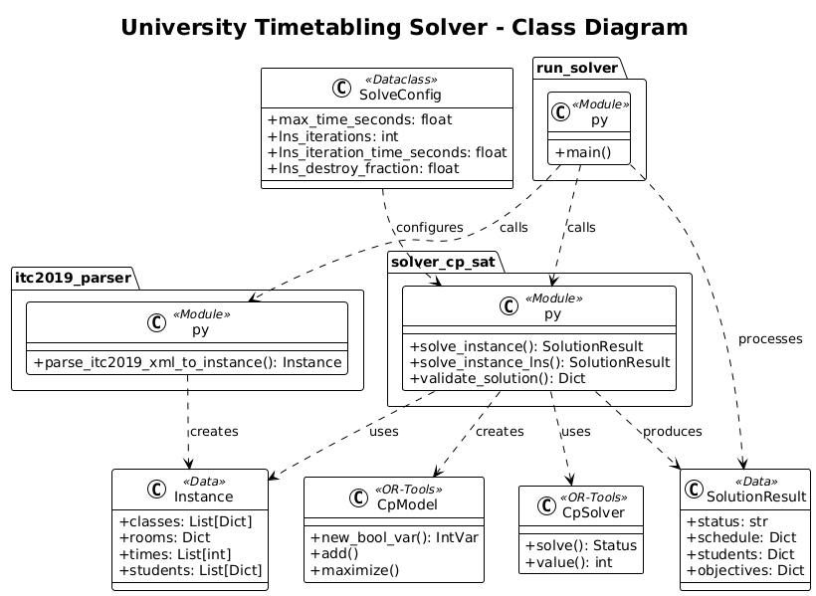
Class Diagram

Slide 5
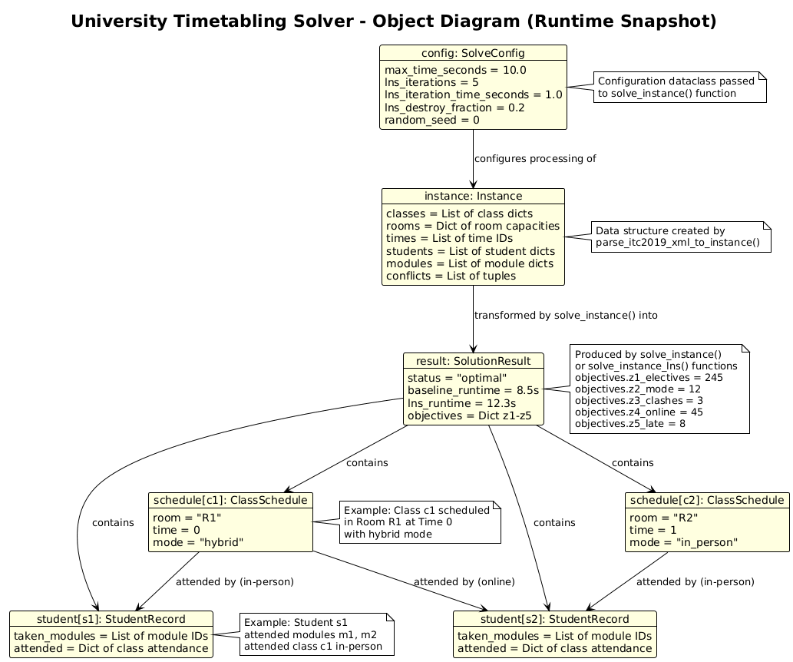

Object Diagram

Slide 6
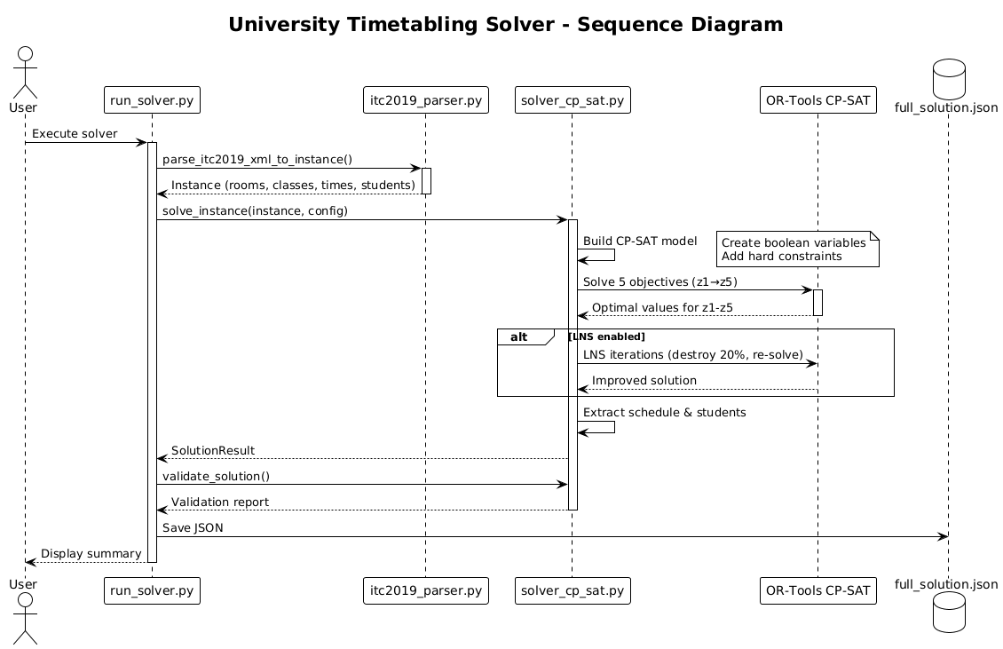
Sequence Diagram

Slide 7
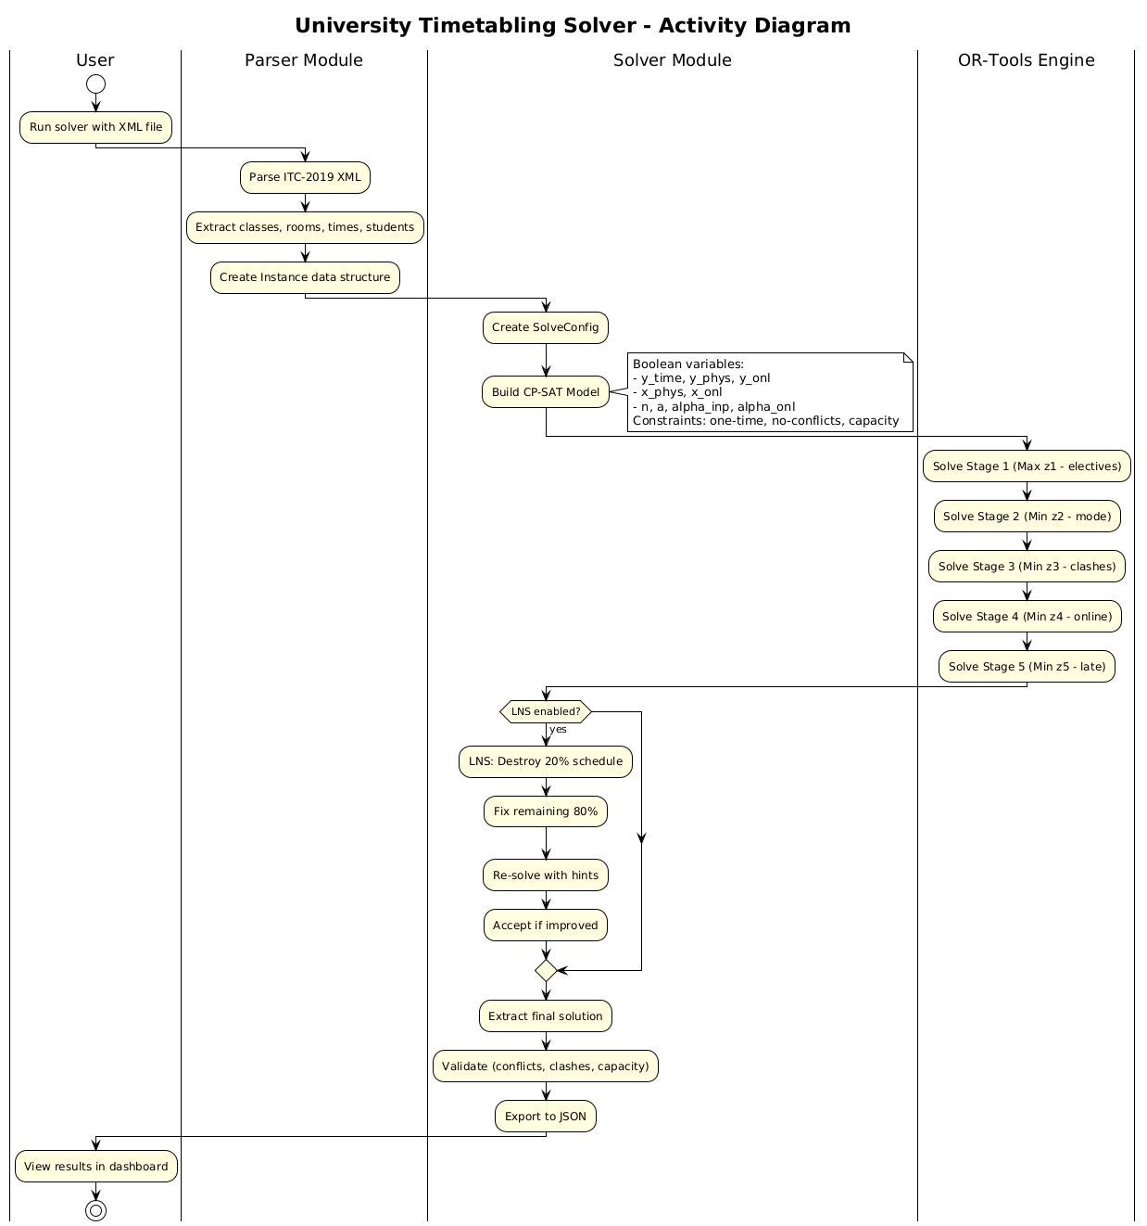
Activity Diagram

Slide 8
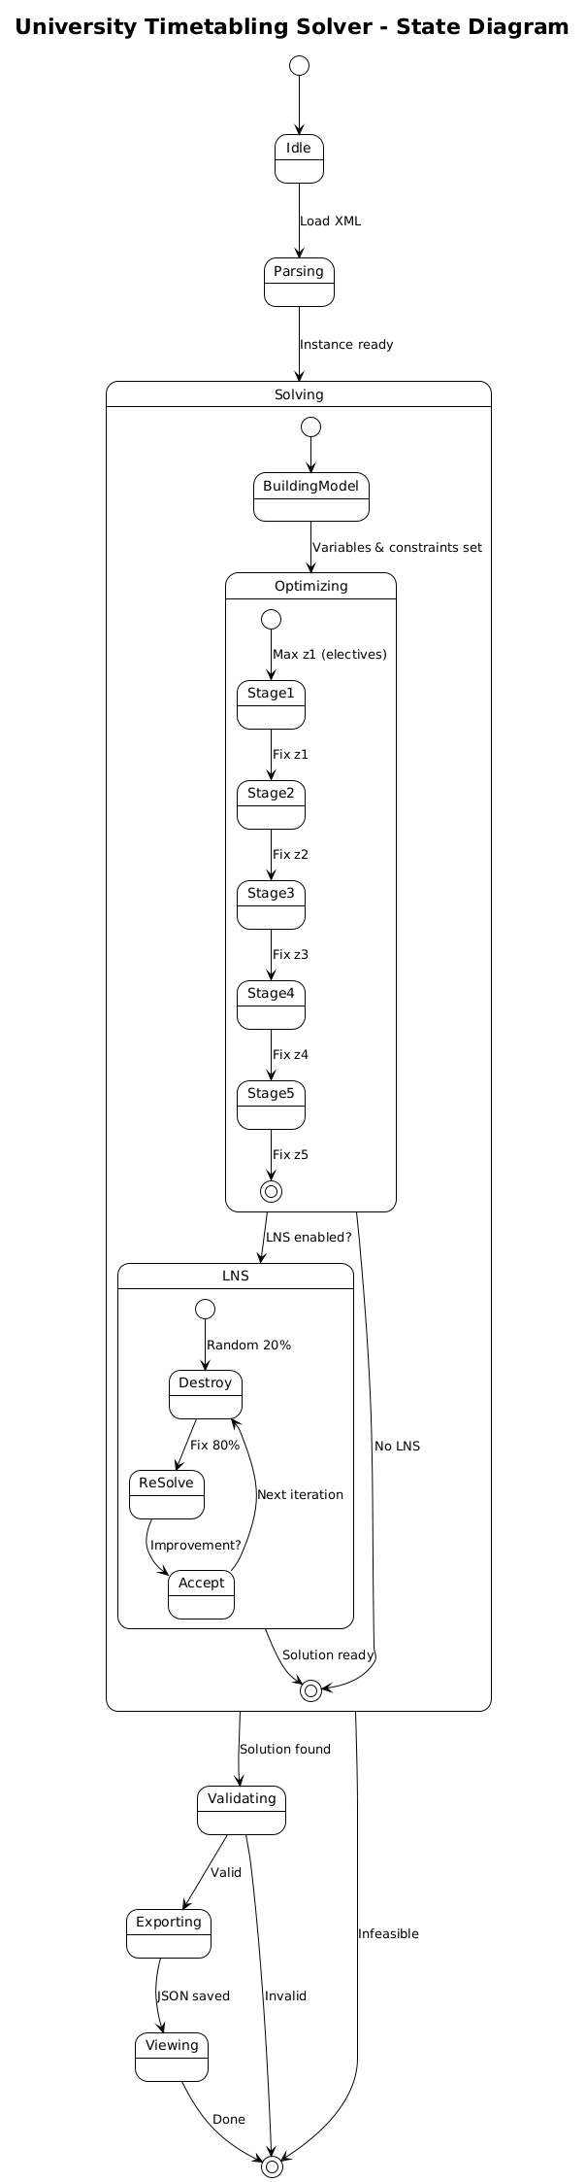
Statechart Diagram

Slide 9
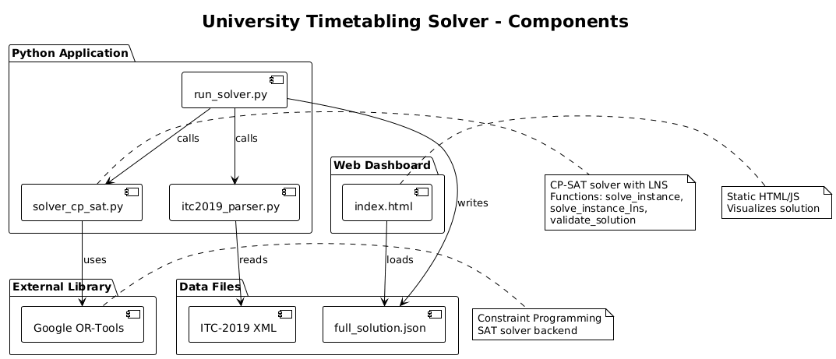
Component Diagram

Slide 10
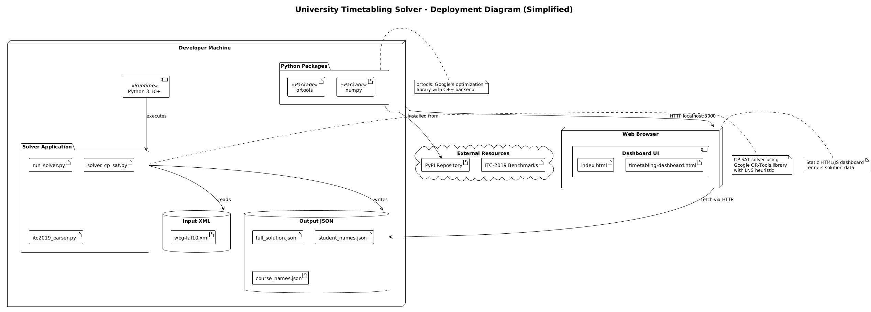
Deployment Diagram

